Slide 1
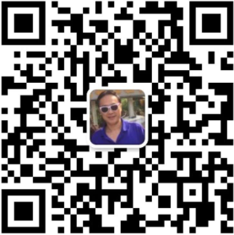
Web3 DDNS
What’s in a name?
wechat: zhibinlei
email: zblei@ust.hk
Prof. James Lei
HKUST
Institute of Web3.0 HK
ASTRI（前香港应用科技研究院）
AI/Web3.0/Network Language/Culture/Society
Meaning/Value Compute/Data

Slide 2
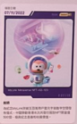
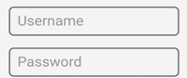
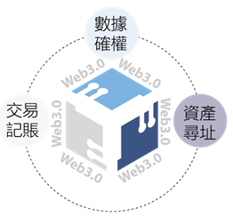
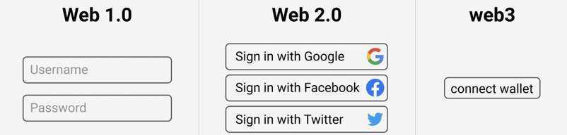
Web3.0 for Data Asset Access
https://www.ust.hk
Web3.0://mind33762/peter/HKUST/NT/HK
Read webpages
Login social network
Platform owns data
Asymmetric
Asset Address/Locator 资产寻址
Smart contract points to your wallet

Slide 3
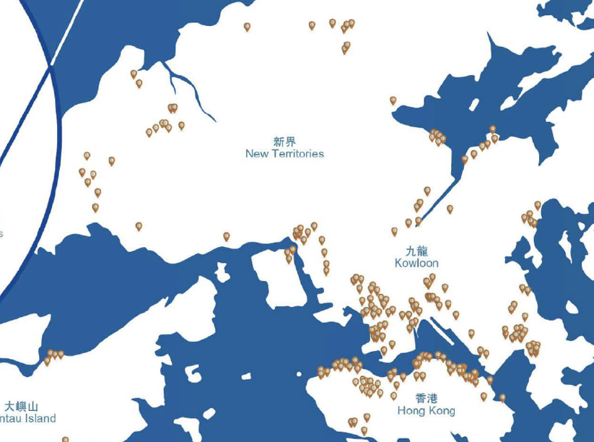
Smart contract points to your data wallet
Data rights ownership: time, place, scene, model, logic – packetized digital rights object
Web3.0://mind33762/peter/HKUST/NT/HK
Web 1.0: web pages -> e-commerce
Web 2.0: mobile app -> social network
Web 3.0: data prosumer (producer and consumer: data asset locator)

Slide 4

Web2 App
Platform：google, wiki，email，SMS，SN，Zoom，GPS，wearable
……
Web2 Server
iCloud
Apps：
App1（edu）App2 （health）
App3 （invest）
…….
Network
Tencent
App Server
Phone Storage
User data/value belongs to platform
Mobile Phone

Slide 5
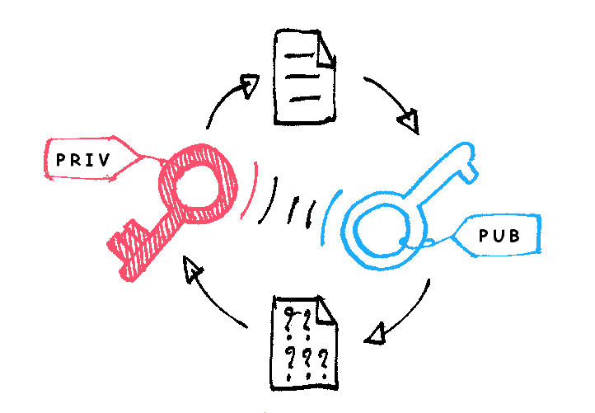
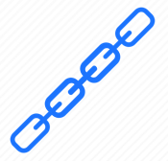
Web3 App
Platform：google, wiki，email，SMS，SN，Zoom，GPS，wearable
……
Web3 Server
iCloud
Apps：
App1（edu）App2 （health）
App3 （invest）
…….
Network
App Server
Tencent
Storage/Data
Compute/AI
Data Wallet
Digital $
Game-Fi
dApp
Private Key
Phone Storage
User data/value controlled by user
Mobile Phone

Slide 6

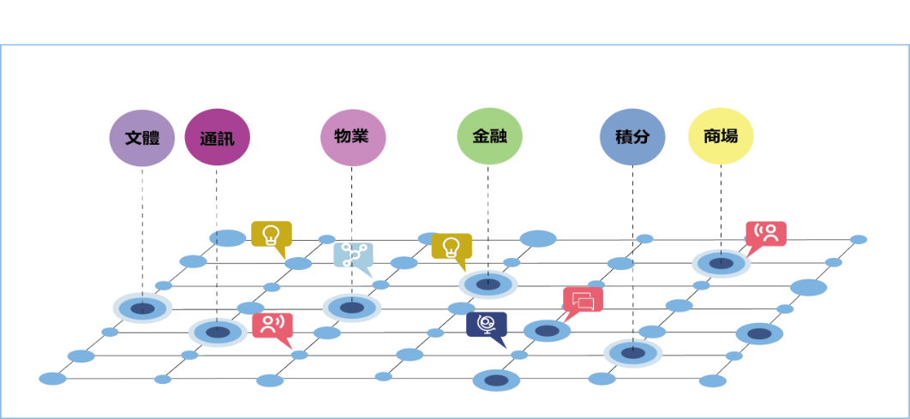

Data producer value creator
Digital Economy Web3.0
Data as Assets– Trust Fabric, Value (network, AI), Symmetric
Web3.0
Connect wallet
web3.0://mind33762/peter/HKUST/NT/HK
Daily Life as Data Prosumer
Common Trust Ledger
Common Ledger as Society Trust Fabric

Slide 7

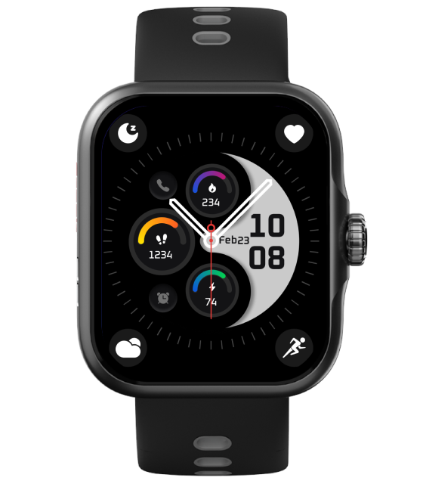
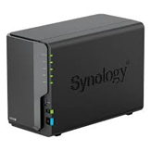
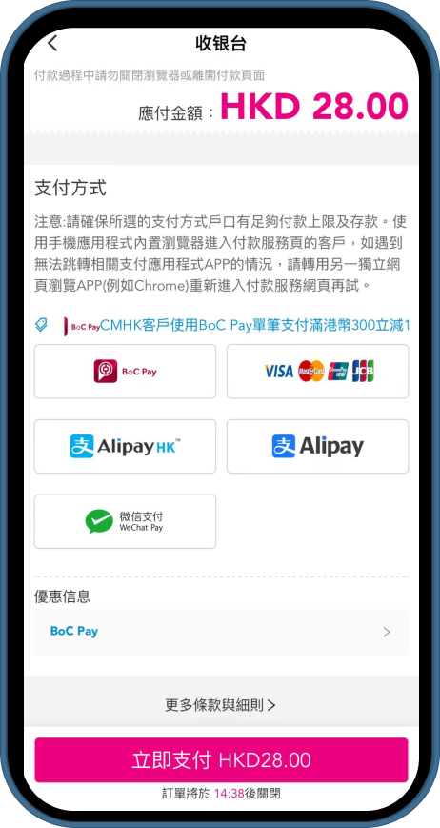
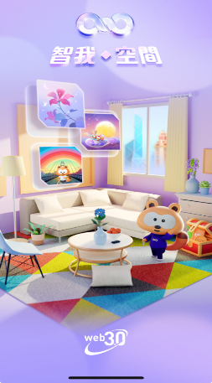
DePIN: Personal Web3 Server
Public web3 data asset networking with AI computing cloud
Built In DID + DDNS
Decentralized Storage & AI Computing
Users can access their Web3 assets at any time
An AWS / Google Cloud alternative
P2P Trading & VPN Nodes
Users can share storage & network and earn tokens

Slide 8




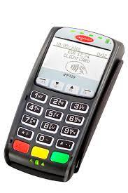






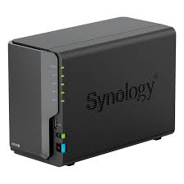




DDNS Chain nodes from cloud/edge, business/consumers
AI Agent Box @Home
telecom/mobile @Cloud
Property Management
Made in China
Communication
API
Shopping Mall
SME/Industry @Edge
Entertainment
Exchange/Bank
Fin/SP/ISP/DC @Business

Slide 9
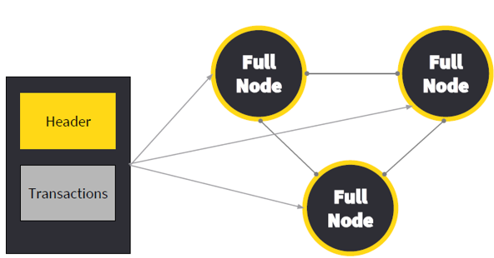
Web3.0HK API for Data Asset
Token_Function_Call ( App_Para || Chain_Para ）
Web3.0://mind33762/Peter/HKUST/NT/HK
App，Service，Business
TokenizationAsset-1
Tokenization Asset-2
Tokenization Asset-3
Business
Token
Model
Project 1
Process
Project 2
Process
Project 3
Process
Product 1
Structure
Product 2
Structure
Product 3
Structure
DDNS Chain Nodes & Public Blockchain
Telecom and data Network

Slide 10
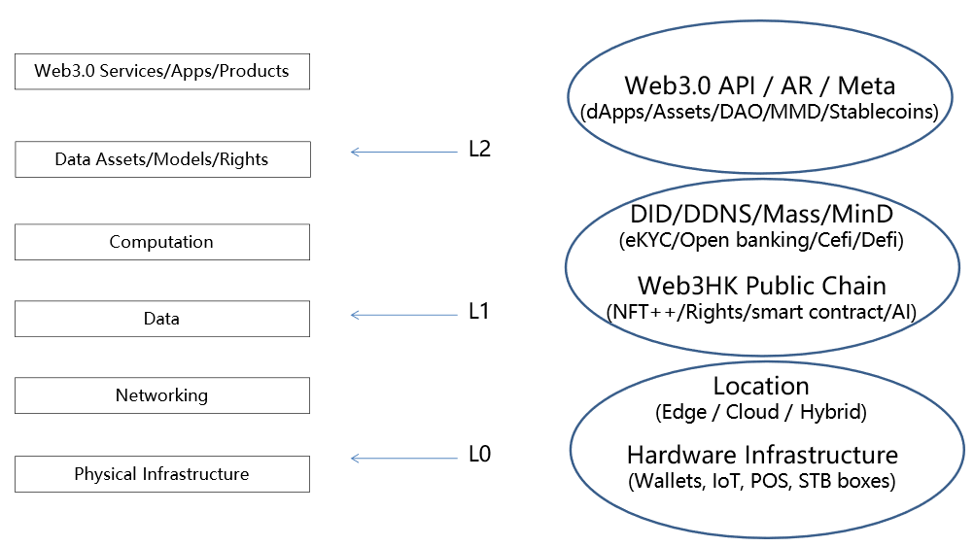
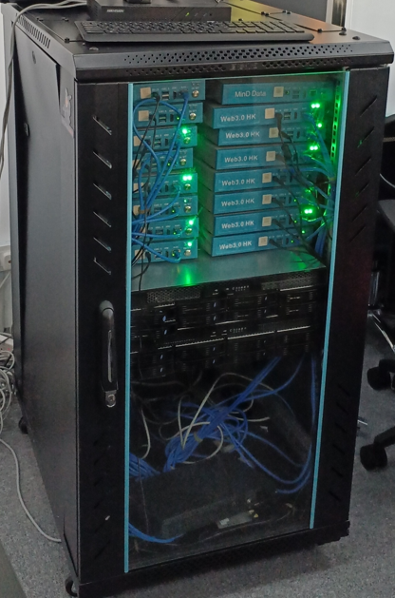
DDNS trial chain nodes & token launch

